Slide 1
AIRS, Weather Prediction and Re-Analysis
ECMWF
IASI
AIRS
there are a few AMSU-A
Forecast error reduction (%)
Cardinali, 2011 + several more studies
AIRS has been absolutely critical:
For improving forecasts over last 20 years
For improving re-analysis products (ERA, MERRA)

Slide 2
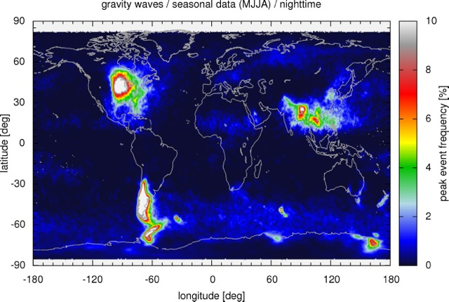
AIRS and Atmospheric Gravity Waves:
A Discovery Story
Hoffmann (2013), Alexander and co-authors – several publications
Key gravity wave source regions identified by AIRS
AIRS has helped discover a new key Asian monsoon region

Slide 3
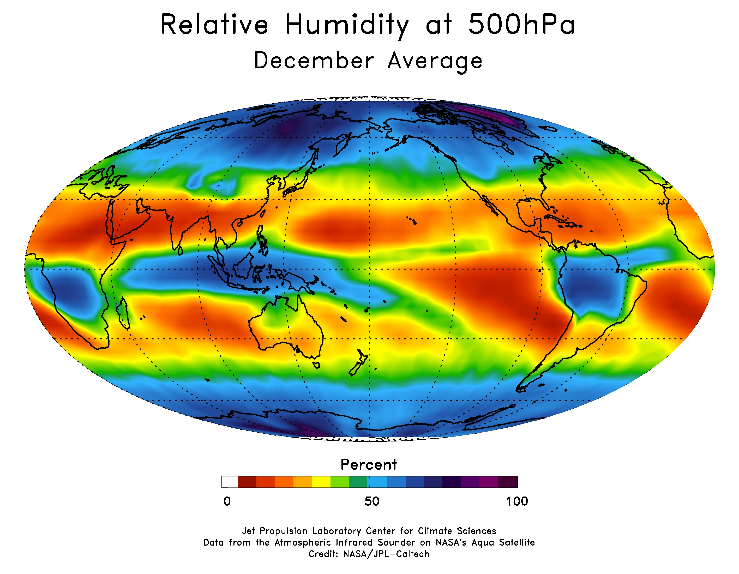
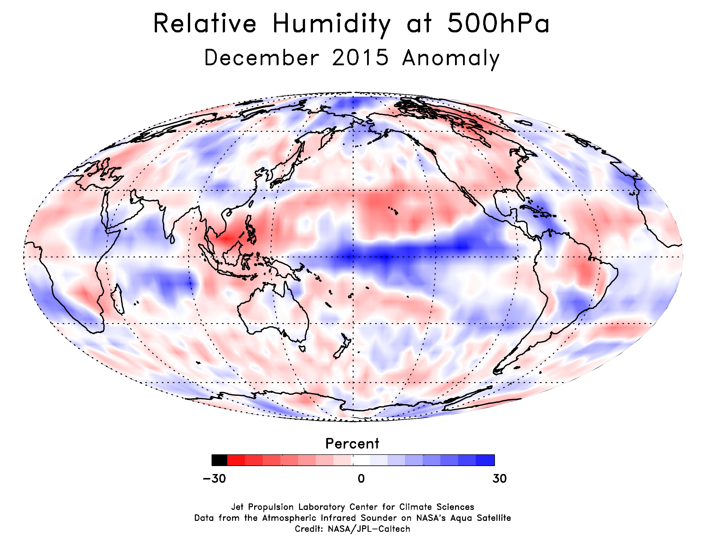
Ocean-Atmosphere Variability: ENSO
AIRS probes into the vertical structure of the atmosphere: e.g. Significant ENSO changes in mid-tropospheric relative humidity
Kahn, co-authors and others
Long records allow to study several ENSO events and to better understand the impacts of - and what controls - ENSO

Slide 4
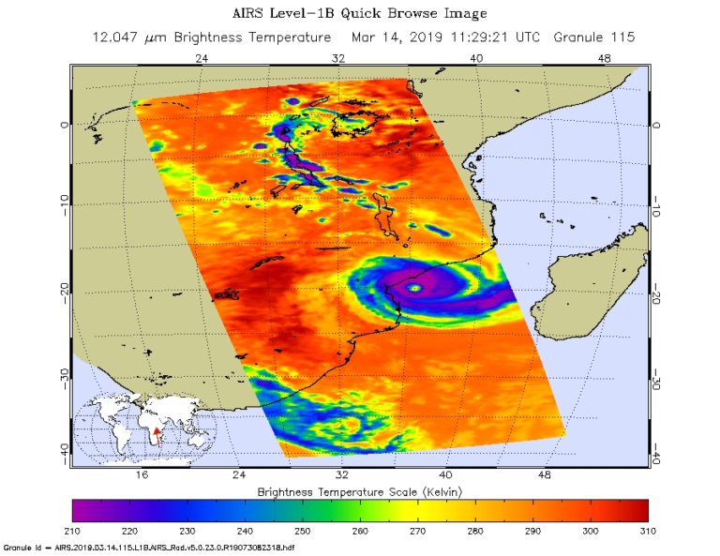
Severe Weather from Space: How Severe Storms Change with Climate
Tropical cyclone Idai 2019
Beira, Mozambique
X
Infrared (IR) observations from AIRS
Severe storms have very cold cloud tops
https://airs.jpl.nasa.gov/news/160

Slide 5
Severe Weather and Climate
How do severe storms/precipitation change with climate?
Water vapor changes follow Clausius-Clapeyron (~ 7%/K)
[ atmospheric RH ~ constant ]
Global mean precipitation much less than C-C (~ 2-3 %/K)
Will extreme precipitation change much faster?
Allen & Ingram, Nature 2002

Slide 6
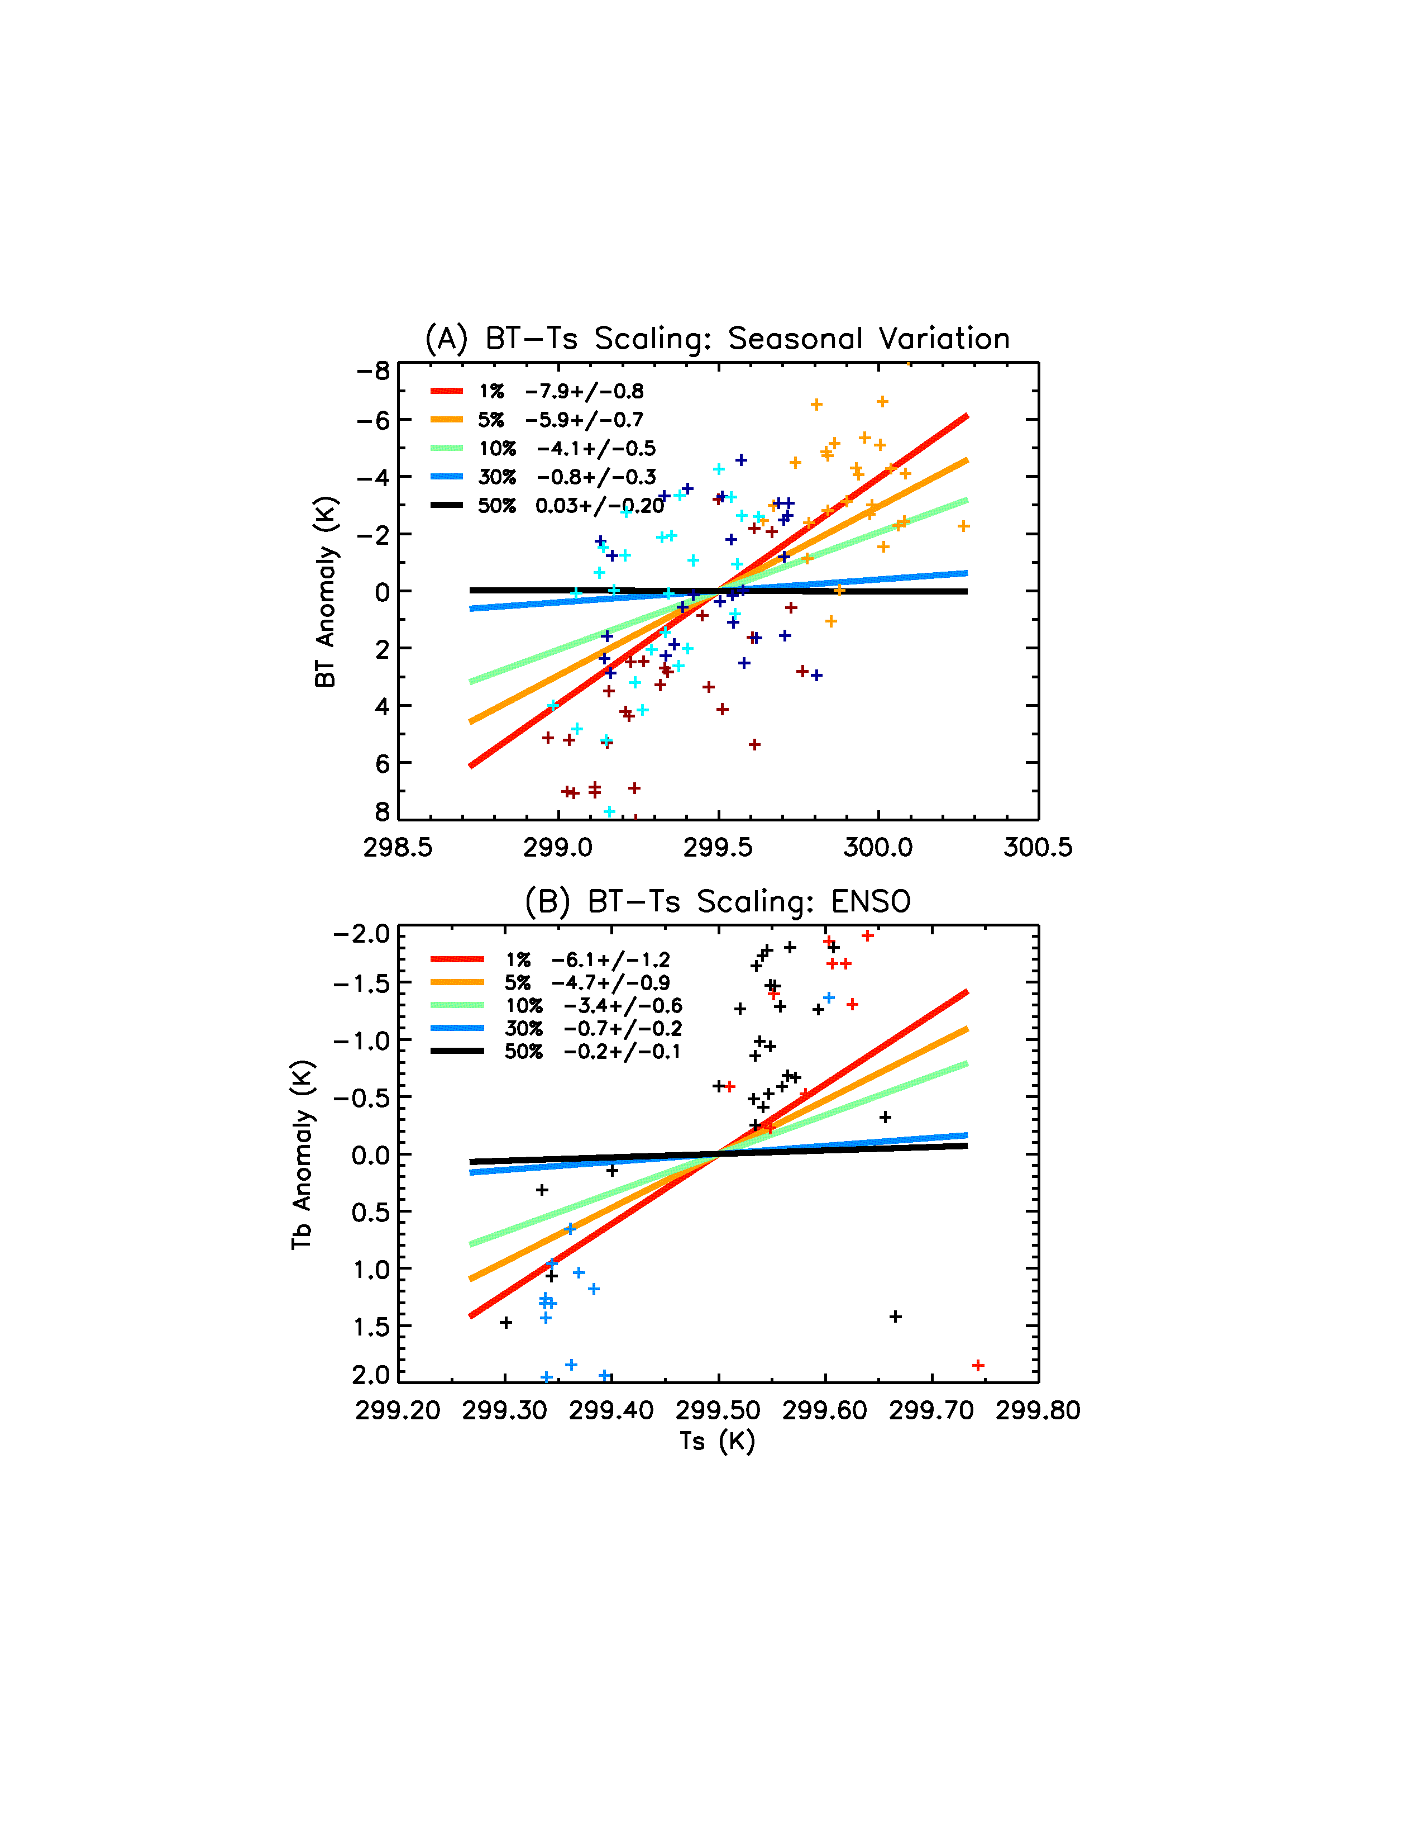
AIRS radiances and Severe Weather
Extreme storms have cold cloud tops
Red line: very cold cloud tops
more extreme
less extreme
Points: colors refer to seasons
Tropical ocean SST(K)
Aumann, Wong, and co-authors – several papers
Very cold cloud temperatures decrease fast with warmer ocean
More severe storms increase faster with ocean temperatures
Could imply significant future increase in severe storms
Notes:
Other %tiles regressions are overlaid.

Slide 7
AIRS Version 7
AIRS version 7 L2 and L3 is publicly available at DAAC for full mission (since July 2020)
Evaluation against 500 sondes over subtropical Pacific (MAGIC campaign)
AIRS v7 improves temperature and water vapor retrievals in lower atmosphere (PBL)
AIRS single-footprint retrievals are being evaluated
Susskind, Blaisdell, and colleagues
Yue and co-authors

Slide 8
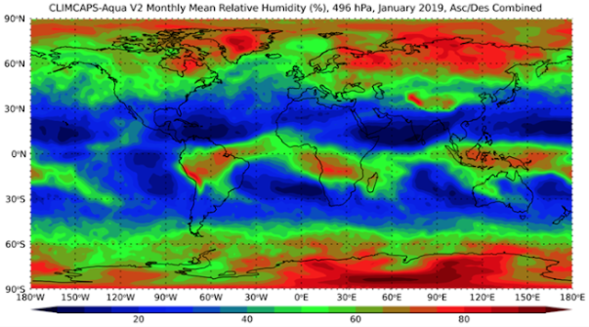
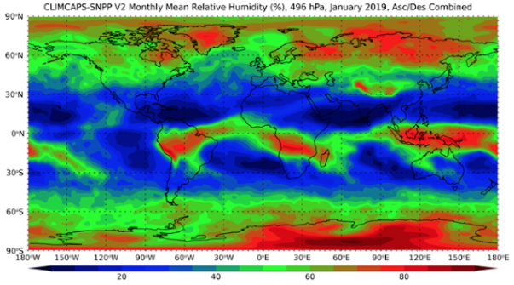
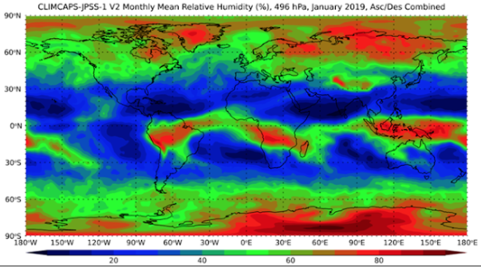
Unified Sounder Retrieval Algorithm
CLIMCAPS Aqua/AIRS has been publicly released June 2021
CLIMCAPS uses radiances from all sounders on Aqua, SNPP, and JPSS-1/NOAA-20
Vertical profiles of temperature, water vapor, trace gases, cloud and surface properties
Figure: Relative humidity (Jan. 2019) at 500 hPa from Aqua (IR-only), SNPP and NOAA-20 satellites, from CLIMCAPS (Smith and Barnet, 2020)
Notes:
8

Slide 9
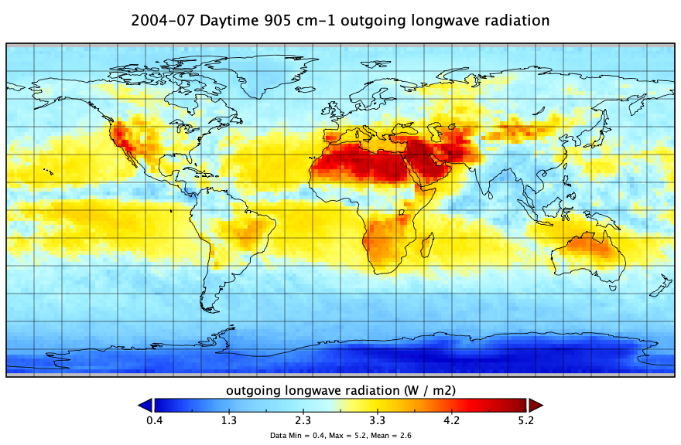
AIRS Spectral OLR
New L3 monthly spectral outgoing longwave radiation (OLR) product (developed by Xianglei Huang et al, 2008, 2010, 2014):
Spectrally resolved OLR, spatially gridded in 2°x 2°grid cells
Spectral flux at 10 cm⁻¹ resolution
Compared against CERES and re-analyses
Contains information on trends in narrow bands
Data record: 2002 – present

Slide 10
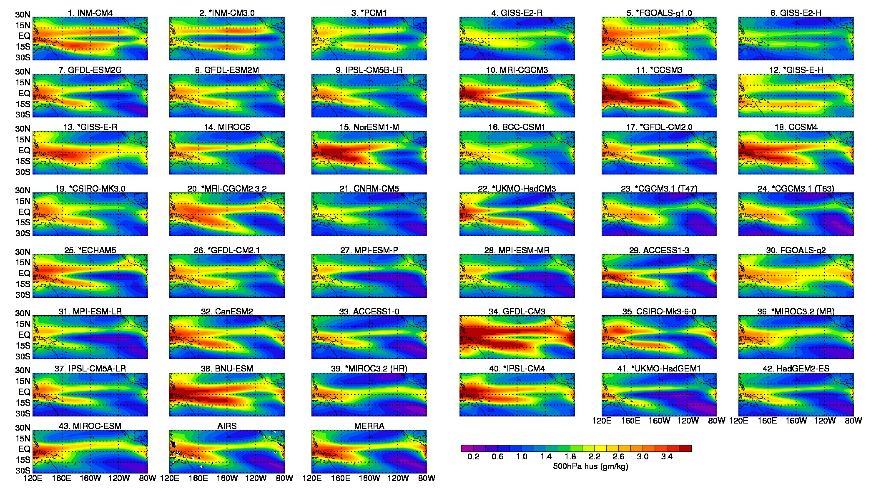
AIRS and Climate Model Validation
AIRS data was used extensively to evaluate climate models from the latest Climate Model Intercomparison Project (CMIP6)
These models are the foundation for the most recent IPCC Assessment Report (AR6)
AIRS data and papers were cited numerous times in the latest IPCC
500 hPa humidity from AIRS and CMIP climate models
Tian and co-authors
Notes:
10

Slide 11
AIRS and IPCC
Courtesy of Hyon and colleagues

Slide 12
AIRS CO and COVID-19: East Asia in Feb 2020
AIRS CO anomalies February 2020
Courtesy of Payne & Licata
Beijing
Chengdu
COVID-19 lockdown
Fires
AIRS CO anomalies show impact of fires and COVID-19 lockdown

Slide 13
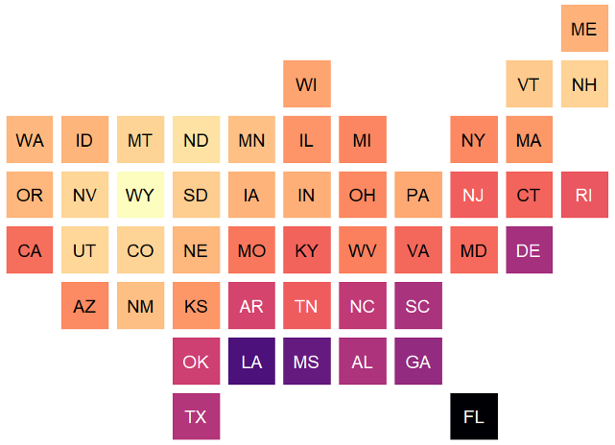
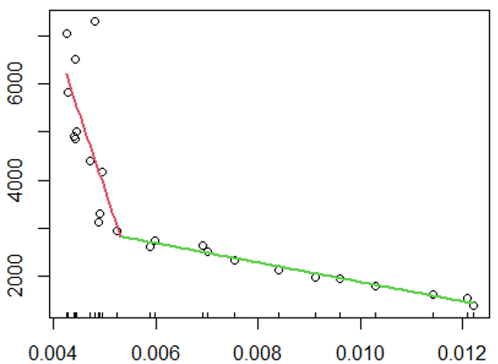
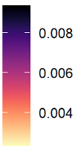
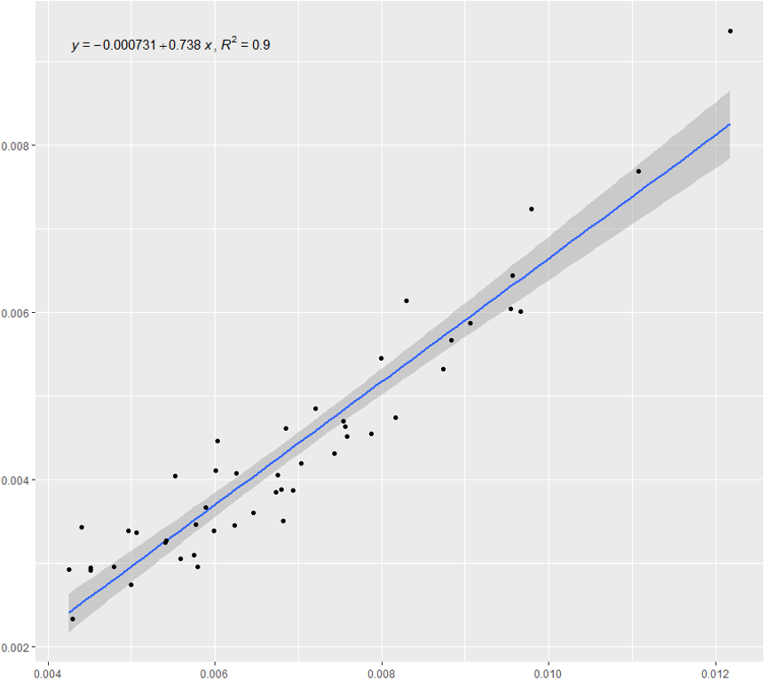
AIRS, Humidity and Influenza
Serman and co-authors, 2022
Arkansas, 2003-2015
Breakpoint signals typical onset of influenza outbreaks
Avg Weekly Influenza Cases
Avg Weekly Specific Humidity
State breakpoint estimates across US
Key points:
Each state has an average weekly humidity breakpoint that signals influenza onset
Linear relation between state humidity breakpoints and state annual average humidity
Estimated Breakpoint
Average Annual Humidity
Notes:
13
You may add comments here to clarify the work or the results.

Slide 14
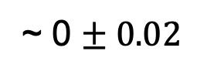
L1 Stability and Continuity
Long (20 years) and remarkably stable record of AIRS hyperspectral radiances/brightness temperatures
AIRS record is long and stable enough to address key climate questions
Strow and DeSouza-Machado (Atmos Meas Tech, 2020):
present a novel generic methodology to study L1 stability
establish stability of AIRS blackbody and 100's of channels to K/decade using independent standards (e.g., CO₂, SST)
~ 0 $± 0.02$
Continuity - Combining AIRS, CrIS, and IASI: Climate Hyperspectral InfraRed Product (CHIRP)
Consistent climate-level radiance time series spanning AIRS + CrIS

Slide 15
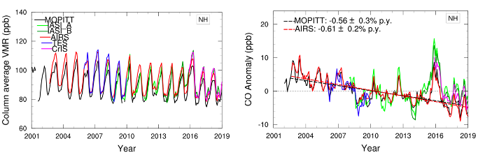
Twenty Years of Climate Monitoring
With twenty years of accurate and stable observations, AIRS can monitor how the 21st Century climate is changing in a unique way
carbon monoxide
Buchholz et al., RSE, 2020
Monitoring carbon monoxide (CO) from space is critical to study the impact of fossil fuel burning and wildfires on atmospheric composition
AIRS is healthy and can continue to monitor climate change for several years

Slide 16
Aqua: Mean Local Time
By late 2026 Aqua may not have enough power to operate

Slide 17
Summary
AIRS is 1st hyperspectral IR sounder and was launched in 2002
Provides global daily observations of key atmospheric properties
Climate monitoring of key properties (e.g., T, q, CO₂, CO, OLR, clouds)
Critical to address key climate questions: e.g. How clouds and extreme weather change with climate; How Arctic responds to climate change.
Historical legacy of AIRS: Long (20 years) and remarkably stable record of AIRS hyperspectral radiances
Climate science requires ability to measure trends of order 0.1 K/decade
AIRS instrument trends/drifts are < 0.1 K/decade

Slide 18
Future
Remarkably accurate and stable AIRS 20-year record is unique for climate monitoring: forcings, feedbacks, extremes
Budget pressure on Aqua (EOS)
Great excitement to use/assimilate AIRS at different times of day ➣ significant potential impact on weather forecasts
AIRS/CrIS/(IASI) continuity: CHIRP, CLIMCAPS, others
PBL: Decadal Survey Incubation Targeted Observable
But nothing can replace a few more years of AIRS
The best is yet to come

Slide 19
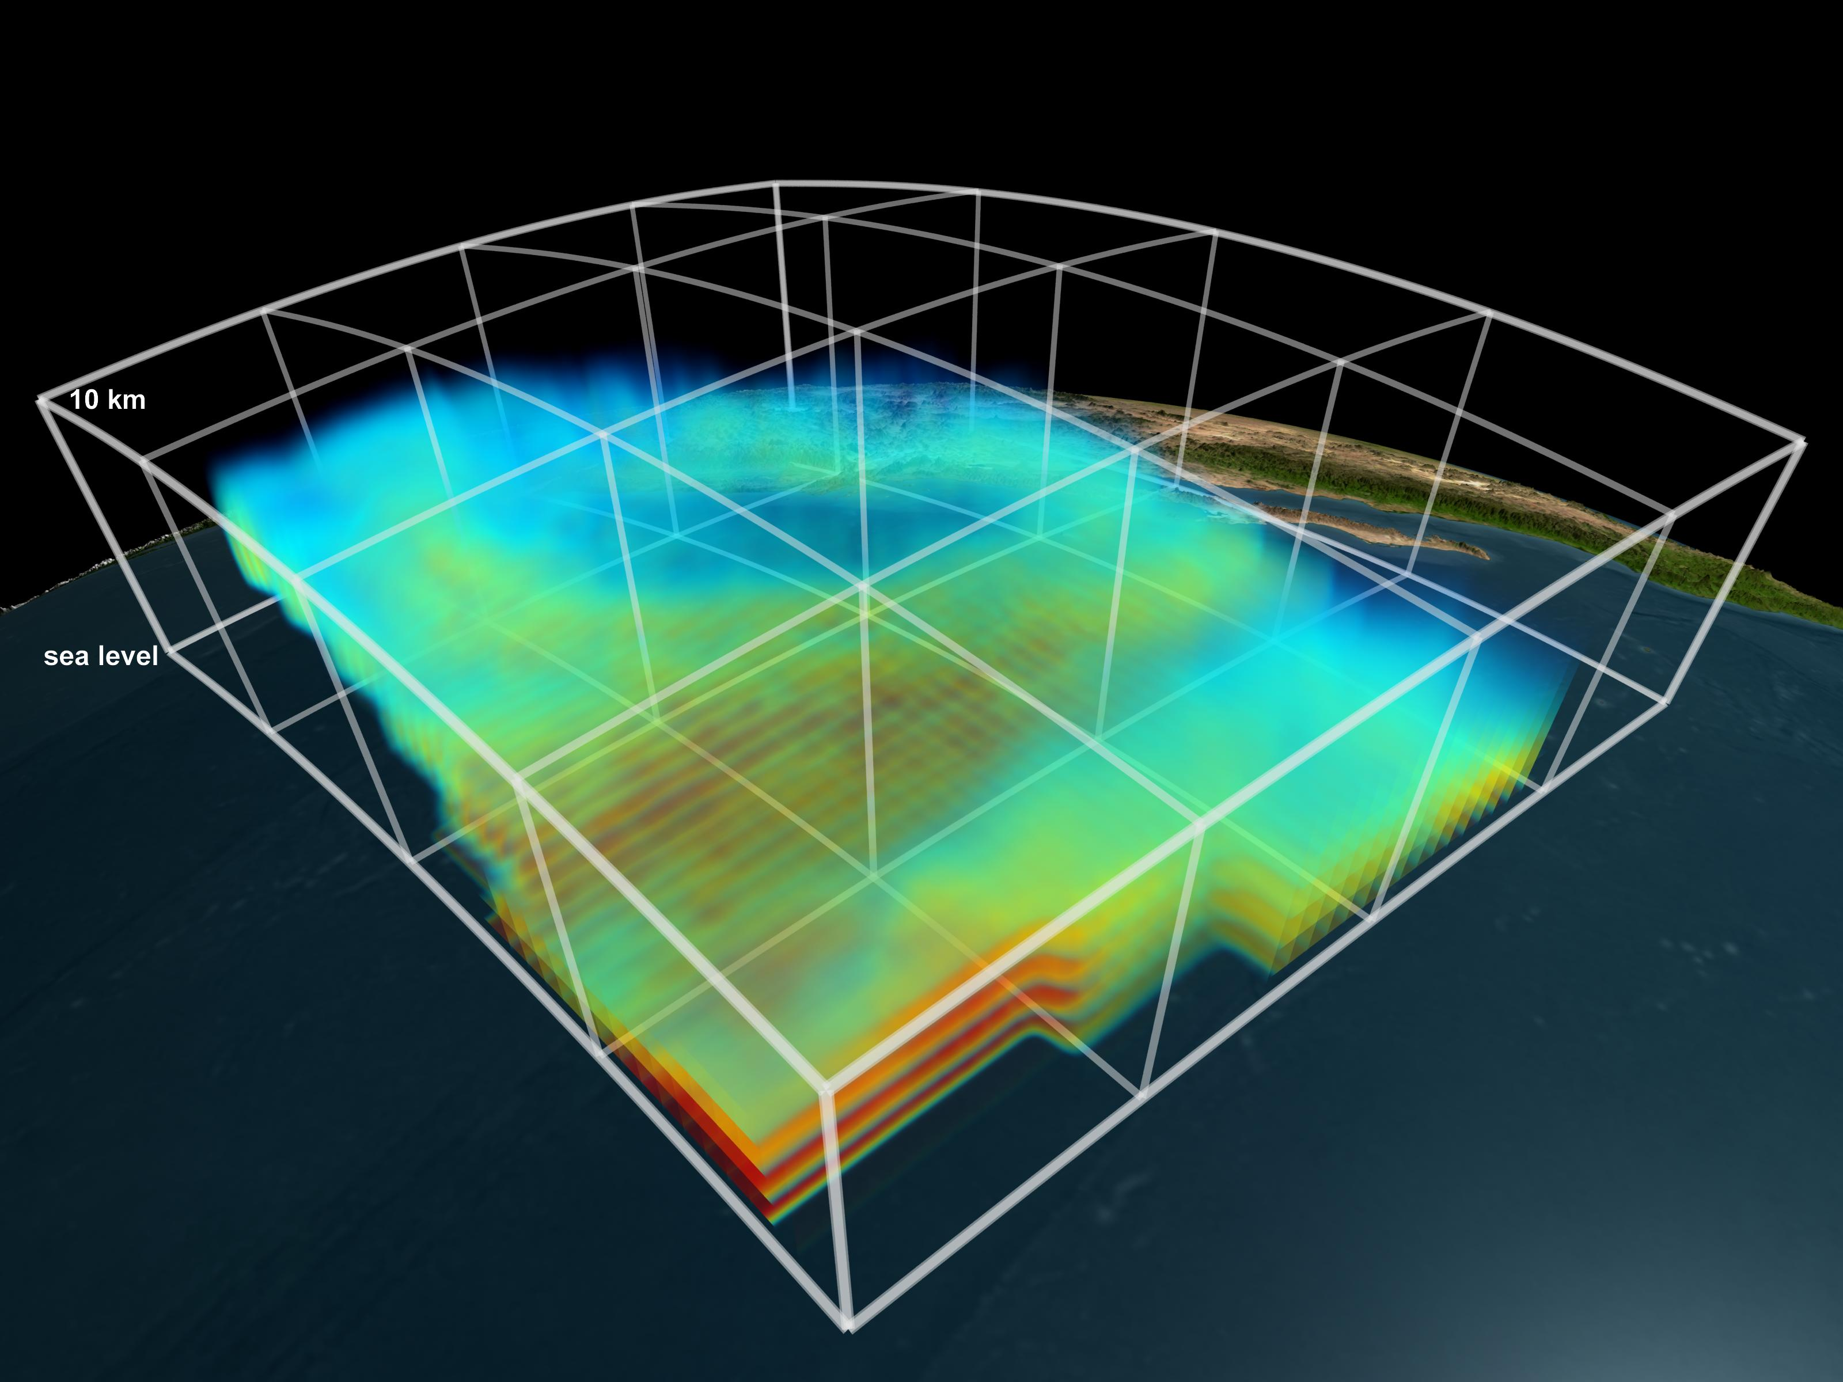
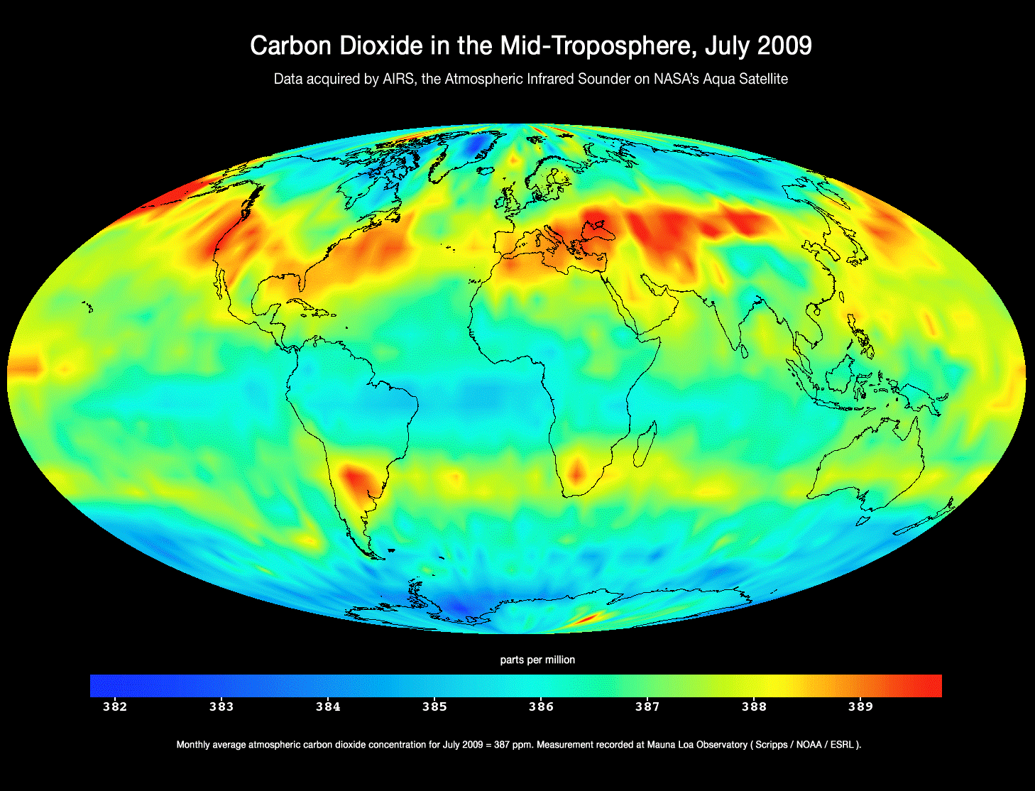
Atmospheric Infrared Sounder
AIRS/AMSU/HSB
First measurements of the three-dimensional structure of temperature and water vapor from a global perspective
Water vapor
Tropical cyclone Idai 2019
AIRS radically improved global weather forecasts
First maps of the global meandering of carbon dioxide

